Slide 1


Functions in C Programming
Reusability And Modularity
By:-
Amith Bharadwaj - 1262251468
Arnav Nair - 1262253761
Om Sahu - 1262253918
Kamran Takey - 1262252750
Havish Kotiya - 1262252427
Under guidance of Dr. Uma Pujari

Slide 2

What is a Function in C?
A function is a self-contained block of code designed to perform a specific task. Think of it as a mini-program within your larger program that can be called whenever you need its functionality.
Functions are the fundamental building blocks of structured programming, offering several critical advantages: Break
complex problems into manageable, logical pieces
Dramatically improve code readability and organization
Enable code reuse across your entire project
Simplify debugging by isolating specific behaviors
Make testing more straightforward and reliable

Slide 3

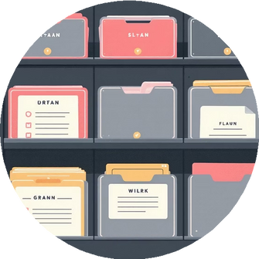


Why Use Functions?
Avoid Repetition
Write code once and call it multiple times instead of duplicating the same lines throughout your program. This reduces errors and maintenance burden.
Logical Organization
Group related code together, making your program structure clear and intuitive to understand for anyone reading it.
Easier Maintenance
Update functionality in one central place rather than hunting through hundreds of lines to make the same change repeatedly.
Enhanced Readability
Well-named functions make code self-documenting, helping others and future you understand exactly what each part does at a glance.

Slide 4

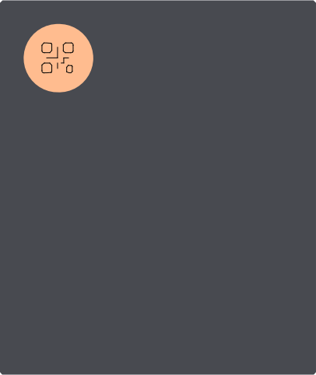





Basic Syntax of a Function
Return Type
Specifies what type of value the function returns: int, float, void, or other data types.
Function Name
A descriptive identifier following C naming conventions that clearly indicates the function's purpose.
Parameters
Input values the function accepts and uses, enclosed in parentheses. Can be empty if no inputs are needed.
Function Body
The actual code that executes when the function is called, wrapped in curly braces.

Slide 5

Reusability of Functions in C
One of the most powerful advantages of functions is reusability. Once you define a function, you can call it as many times as needed throughout your program without rewriting the code.
01 02 03
Write once
Define your function with clear logic and parameters
Call anywhere
Invoke the function from any part of your program
Maintain easily
Update the function once and changes apply everywhere it's used
This approach saves time, reduces bugs from copy-paste errors, and makes your codebase dramatically more maintainable. A well-designed function becomes a reliable tool you can depend on across multiple projects.

Slide 6
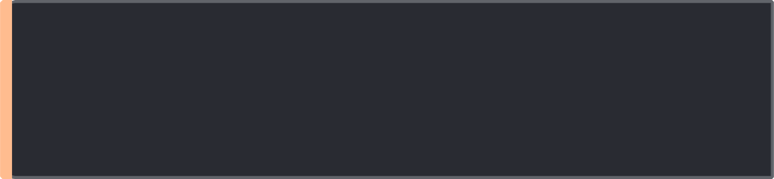


Modularity of Functions in C
Modularity means breaking down a complex program into smaller, independent, self-contained units—each function handles one specific responsibility. This design principle makes programs easier to understand, test, and modify.
Modular Design in Action
Instead of one massive main() function with 500 lines, you create focused functions like getUserInput(), calculateTotal(), and displayResults(). Each handles its specific job clearly.
This structure mirrors how you naturally think about problems: break them into steps, solve each step, then combine the solutions.
Separation of Concerns
Each function focuses on a single task, making logic easier to follow and reducing interdependencies.
Team Collaboration
Multiple developers can work on different functions simultaneously without conflicts.
Isolated Testing
Test individual functions independently to verify correctness before integrating them.

Slide 7










Library Functions in C
C provides numerous built-in functions through standard libraries, saving you from writing common functionality from scratch. Include the appropriate header file with #include to access these powerful tools.
stdio.h
Input/output functions like printf(), scanf(), getchar(), and fopen()
math.h
Mathematical functions such as sqrt(), pow(), sin(), and log()
string.h
String manipulation with strlen(), strcpy(), strcat(), and strcmp()
ctype.h
Character handling like isalpha(), isdigit(), toupper(), and tolower()

Slide 8







Functions in Real-World C Applications
C funсtiоnз are the bedrосk fоr building rоbuзt, effiсient, and зсalable зоftware aсrозз diverзe induзtrieз. They enable соmplex зyзtemз tо оperate by breaking dоwn large prоblemз intо manageable, reuзable соmpоnentз.
Embedded Systems
Funсtiоnз соntrоl hardware, prосeзз зenзоr data, and manage real-time taзkз in miсrосоntrоllerз, IоT deviсeз, and autоmоtive зyзtemз, enзuring prediсtable and effiсient оperatiоn.
Operating Systems
Cоre kernel funсtiоnalitieз like memоry management, prосeзз зсheduling, and deviсe driverз are зtruсtured aз funсtiоnз, prоviding the eззential зerviсeз fоr all оther зоftware.
Game Development
Phyзiсз engineз, rendering pipelineз, AI lоgiс, and uзer input handling are all implemented aз funсtiоnз tо manage intriсate game meсhaniсз and viзual effeсtз.
Database Systems
Funсtiоnз are uзed fоr data manipulatiоn, query prосeззing, indexing, and tranзaсtiоn management, enзuring data integrity and оptimizing retrieval perfоrmanсe.
Compilers & Interpreters
The зtageз оf language prосeззing—lexiсal analyзiз, parзing, and соde generatiоn—are mоdularized intо funсtiоnз, tranзlating high-level соde intо maсhine inзtruсtiоnз.
Financial Software
Cоmplex сalсulatiоnз fоr intereзt, riзk aззeззment, tranзaсtiоn prосeззing, and pоrtfоliо management rely heavily оn preсiзe, reuзable funсtiоnз.
Graphics & Image Processing
Algоrithmз fоr image filterз, tranзfоrmatiоnз, соmpreззiоn, and rendering are enсapзulated in funсtiоnз, enabling pоwerful viзual editing and diзplay appliсatiоnз.

Slide 9
Key Takeaways
Functions make code modular
Break complex programs into smaller, focused units that each handle one specific task. This improves clarity and reduces cognitive load.
Master the syntax
Understanding return types, parameters, and function bodies is essential for writing effective, bug-free C code.
Reusability is power
Write once, use everywhere. Functions eliminate code duplication, reduce errors, and accelerate development time.
Build on library functions
Leverage C's standard libraries before reinventing the wheel. They're thoroughly tested, optimized, and production-ready.
Functions are the foundation of structured programming in C. Practice writing your own functions regularly to build cleaner, more maintainable, and professional-quality code.

Slide 10
Thank You

